Slide 1
Multi- vs. Unidimensional Semantics for Discourse Asymmetry in Constructions with Propositional Verbs
Formal Philosophy 2025
Daria Popova, HSE University
24 June 2025

Slide 2
The Roadmap
A: Who said that Dean has left town?
B: #Dean has left town, Sam said. / Sam said that Dean has left town.
What is the multidimensional and the unidimensional approach to discourse asymmetry?
Are the two approaches juxtaposed or are they complementary?
First, we will introduce the multidimensional approach in terms of conventional implicatures
Second, we will introduce the unidimensional approach in terms of discourse updates
Third, we will introduce the multidimensional approach in terms of monads
We will apply the unidimensional approach in terms of discourse updates and the multidimensional approach in terms of monads to constructions with propositional verbs like in (1)
We will conclude by introducing the idea that the two approaches might be complementary

Slide 3
Conventional implicature dimension
(1) A: Meghan Markle, the actress from Canada, married Prince Harry.
B: No, that’s not true.
⇒ No, Meghan Markle did not marry Prince Harry.
⤃ No, Meghan Markle is not from Canada.
B: True, but actually Meghan Markle was born in California
Potts (2005) introduces two types of dimensions:
an at-issue dimension that is under discussion
a not-at-issue, or conventional implicature, dimension that contributes additional information that is speaker-oriented and non-backgrounded
two dimensions are logically independent from each other
semantic content can flow from the at-issue dimension to the not-at-issue dimension but not vice versa

Slide 4
Dynamic semantics: two types of context updates
John_{x}, who_{x} nearly killed a_{y} woman with his_{x} car, visited her_{y} in the hospital. (AnderBois et al. 2010)
Two types of context updates:
imposition (AnderBois et al. 2010): an informative non-negotiable update of the common ground
proposal (Farkas and Bruce 2010): an informative negotiable update of the common ground

Slide 5
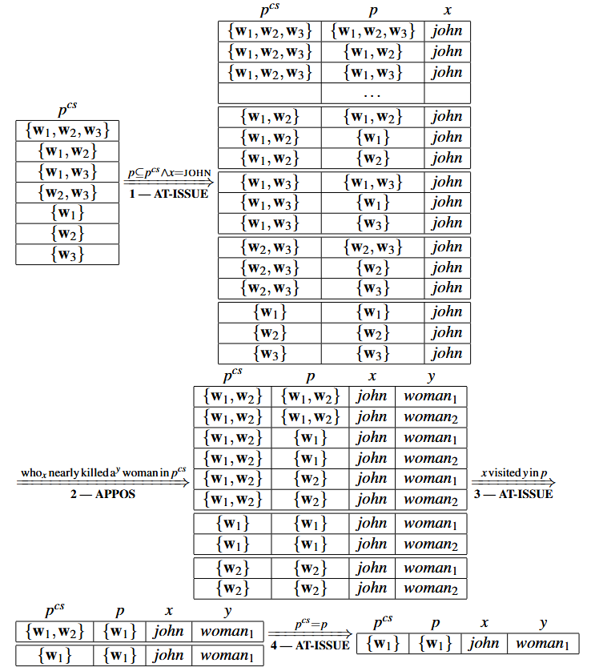
John_{x},
who_{x} nearly killed a_{y} woman,
visited her_{y} in the hospital.
(AnderBois et al. 2010)

Slide 6
Multidimensional approach: monads
M – is a type constructor if it takes any type and returns a new type
for example, we can think of {} as a type constructor which takes a type α and returns a new type {α}, i.e. a type contains a set of values of type α
Any type constructor M that has functions return and bind of the following type is a monad:
return :: α → M α
bind :: M α → (α → M β) → M β
on the compositional level, monads preserve the idea of two independent dimensions, in the post-compositional phase the dimensions can interact
(Shan 2002; Giorgolo and Asudeh 2012, 2014; Charlow 2014)

Slide 7
Monads
(Shan 2002; Giorgolo and Asudeh 2012, 2014; Charlow 2014; Cohn-Gordon):
Quantifier Scope: the Continuation Monad: (α → M t) → M t: Someone loved everyone.
Conventional Implicature: the Writer Monad: M (α, (List t)): Lupin, a werewolf, left Hogwarts.
Presupposition Failure: the Exception Monad: M (Either String α): Dasha met the King of France.
Anaphora: the State (and Set) Monad: (List e) → [M (α, (List e)]: Lupin walked in. He likes Harry.
Intensionality: the Reader Monad: s → M α: Dumbledore believes Barty Crouch Jr is Alastor Moody.
Focus: the Pointed Set Monad: M [α]: Dasha loves linguistics_{FOC}.

Slide 8
Monads
(Shan 2002; Giorgolo and Asudeh 2012, 2014; Charlow 2014; Cohn-Gordon):
Conventional Implicature: the Writer Monad: Lupin, a werewolf, left Hogwarts.
(Writer α) is synonymous to (α, (List t)), pair of values, where the first value is of type α and the second value is of type (List t), a list of truth values
Intensionality: the Reader Monad: Dumbledore believes Barty Crouch Jr is Alastor Moody.
(Reader α) is a synonym for (s → α), where s is the type for worlds.
Reader takes a type α and returns the type of a function from worlds to α.

Slide 9
Constructions with propositional verbs: discourse asymmetry
Constructions with evidential meaning:
A: Who has left town?
B: Dean has left town, Sam said. / Sam said that Dean has left town.
A: Dean has left town, Sam said.
B: No (Dean has not left town/#Sam did not say that).
A: Sam said that Dean has left town.
B: No (Dean has not left town /#Sam did not say that).
Intensional constructions:
A: Who said that Dean has left town?
B: #Dean has left town, Sam said. / Sam said that Dean has left town.
A: Sam said that Dean has left town.
B: No (Sam did not say that).

Slide 10
Constructions with propositional verbs: dynamic semantics
Two types of context updates:
imposition (AnderBois et al. 2010): an informative non-negotiable update of the common ground
proposal (Farkas and Bruce 2010): an informative negotiable update of the common ground
(a) Sam said that Dean has left town
Dean has left town – PROPOSAL
Sam said that Dean has left town – IMPOSITION
EVIDENTIAL MEANING
OR
Sam said that Dean has left town – PROPOSAL
INTENSIONAL MEANING
(b) Dean has left town, Sam said
Dean has left town – PROPOSAL
Sam said that Dean has left town – IMPOSITION
EVIDENTIAL MEANING

Slide 11
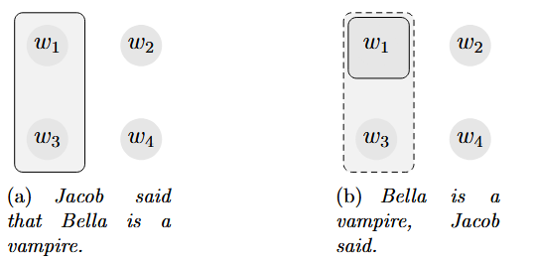
Intensional construction vs evidential construction update
Context Set: {w₁, w₂, w₃, w₄}
⟦Bella is a vampire⟧ = {w₁, w₂}
⟦Jacob said that Bella is a vampire⟧ = {w₁, w₃}

Slide 12
Constructions with propositional verbs: monads
Conventional Implicature: the Writer Monad: Lupin, a werewolf, left Hogwarts.
(Writer α) is synonymous to (α, (List t)), pair of values, where the first value is of type α and the second value is of type (List t), a list of truth values
Intensionality: the Reader Monad: Dumbledore believes Barty Crouch Jr is Alastor Moody.
(Reader α) is a synonym for (s → α), where s is the type for worlds. Reader takes a type α and returns the type of a function from worlds to α.
(a) Sam said that Dean has left town
the Writer Monad – EVIDENTIAL MEANING
OR
the Reader Monad – INTENSIONAL MEANING
(b) Dean has left town, Sam said
the Writer Monad – EVIDENTIAL MEANING

Slide 13
Multidimensional vs. unidimensional approach
the two approaches are traditionally juxtaposed
monads: multidimensionality of the semantic representation with the necessary post-compositional interdimensional interaction
monads: logical independence, speaker-orientation unless embedded
monads: pragmatics and discourse behavior are (not) encoded in the semantic representation, which might be problematic for modelling the interplay between context and speaker-orientation (Harris and Potts 2009) or the interaction with focus and the question under discussion
imposition and proposal: unidimensional semantic representation, two types of updates, logical independence, speaker-orientation, dynamics inside the imposition-proposal pair and competition between the imposition-proposal and proposal-proposal pairs
imposition and proposal: where are the labels introduced and what is their semantic status?
Proposal: the two approaches might be complementary in a sense that we need to know how semantic content enters the context set even if it is modelled in terms of monads

Slide 14

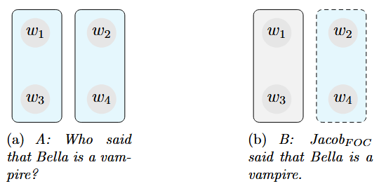

Slide 15
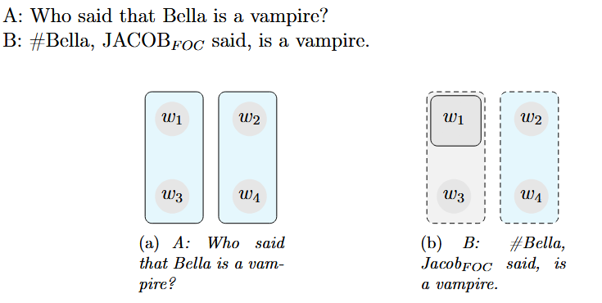

Slide 16
Thank you!

Slide 17
References
AnderBois et al. (2010). Crossing the Appositive/At-issue Meaning Boundary. In Proceedings of Semantics and Linguistic Theory 20.
Barker, Chris (2002). “Continuations and the nature of quantification”. In: Natural language semantics 10.3, pp. 211–242.
Charlow, Simon (2014). “On the semantics of exceptional scope”. PhD thesis. New York University.
Cohn-Gordon, Reuben. “Monad Transformers for Natural Language: Combining Monads to Model Effect Interaction”.
Farkas and Bruce 2010. On Reacting to Assertions and Polar Questions. Journal of Semantics 27:81–118.
Giorgolo, Gianluca and Ash Asudeh (2012). “<M, η,*> Monads for conventional implicatures”. In: Proceedings of Sinn und Bedeutung. Vol. 16, pp. 265–278.
— (2014). “Monads as a solution for generalized opacity”. In: EACL 2014, p. 19.
Harris, Jesse A and Christopher Potts (2009). “Perspective-shifting with appositives and expressives”. In: Linguistics and Philosophy 32.6, pp. 523–552.
Potts, Christopher (2005). The logic of conventional implicatures. Vol. 7. Oxford University Press Oxford.
Shan, Chung-chieh (2002). “Monads for natural language semantics”. In: arXiv preprint cs/0205026.

